Slide 1
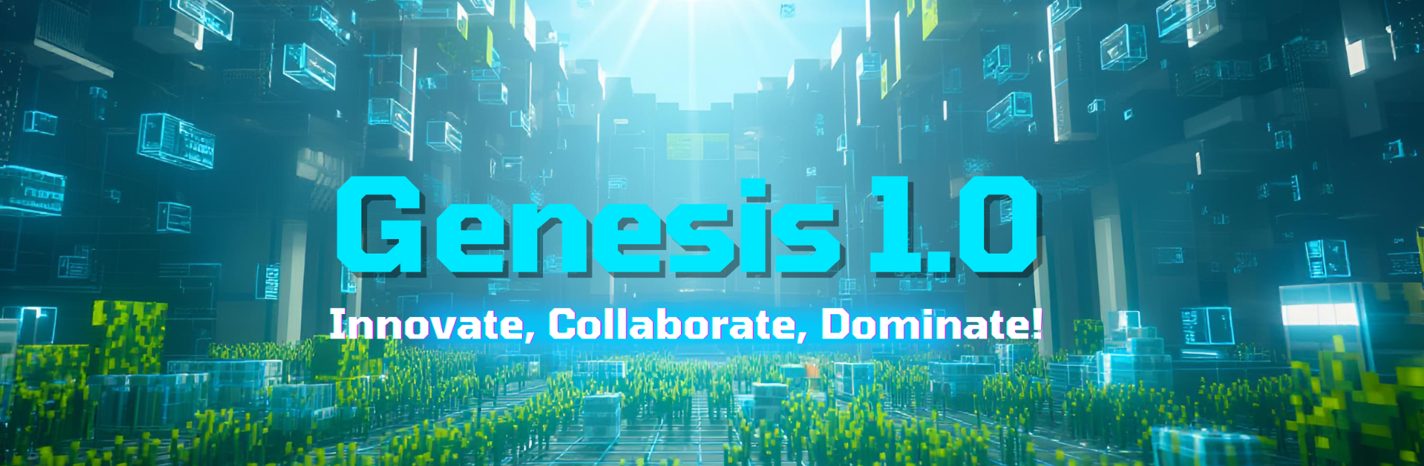
Team Details
  Team name:
  Team leader name:
  Problem Statement: Open Innovation
Team Details
  Team name: OneDev
  Team leader name: Sachin yadav
  Problem Statement: Open Innovation

Slide 2
Brief about your solution and problem statement addressing
GDG On Campus LTCoE
Problem Statement
Most traditional to-do applications list tasks without emphasizing priority. As a result, users often feel overwhelmed and struggle to decide which task should be done first.
There is a need for a simple system that:
Highlights task importance
Reduces Procrastination
Reduces decision fatigue
Confusion on what to do
User ends up doing less important task first and forgets to do the urgent task which leads to panics on deadline

Slide 3
Solution : PriorityTasks
PriorityTask introduces a “priority-first workflow” where tasks are organized based on their importance.
Users can quickly identify high-priority tasks and focus their energy on meaningful work.
The application keeps the interface minimal and distraction-free, making it suitable for students and individual learners.
AI is integrated for user Assistance not as distraction (AI reply is short and to point)
User can repeat or do the task later option
Clean dashboard and progress bar to keep track of the progress
Login Todos saved for anywhere access

Slide 4
GDG On Campus LTCoE
Opportunities
  How different is it from any of the other existing ideas?
  This is proven method to boast productivity used by President Dwight D. Eisenhower, the 34th President of the United States.It is best for long-term projects and daily todos.This can help user to bring discipline and consistency in his life
  How will it be able to solve the problem?
  The main page of the webapp is minimal with 4 quadrants on the graph of importance V/S urgent.
  User can enter there todos in any of the for quadrant and it is saved for that date.
  There is new Todos for each day so user can keep track of progress, plan in advance and see the past performance to improve.
  User can log-In by Google or Github account by Nextauth and start saving his data on our servers ( for not sign-in users there data is stored on localStorage only )
  User can log-in to same account on other devices to access there todo from anywhere
  There is personalization dashboard for each user which shows his satistical overall progress
  Ask AI feature for todos with personalization response

Slide 5
GDG On Campus LTCoE
List of features offered by the solution
There is new page for every date with 4 quadrants on the important V/S urgent graph
Drag and drop feature for each todo in it’s quadrant, to emphasize on the order priority in that quadrant
AI can explain and answer any Todos and can ask any particular query and AI will give answer in 20-25 word.
This has responsive UI for all pages for desktop and mobile mode.
There is 3 dot menu with options of repeating a todo, doing it tomorrow and asking AI abot this todo.
Bottom stick progress bar and user personalization dashboard for users to see progress
Login by Google and Github to save Todos to the MongoDB Atlas database so, user can log-in to there account and acces todos from anywhere and everywhere.
User enters at Todos of the current date and can add Todos for present and any other day using the UI.

Slide 6
GDG On Campus LTCoE
Google Technologies used in the solution :
Gemini-flask-2.5 API key from google AI studios is used as backend to prompt and get response for AI feature.
User prompt is modified before hand to generate a 20-25 word response to the user’s query.
There is a explain AI button on todo card so user can quote a particular todo and ask about it.
Prompt includes username, current date and all todos of the user to generate a personalization response to user.

Slide 7
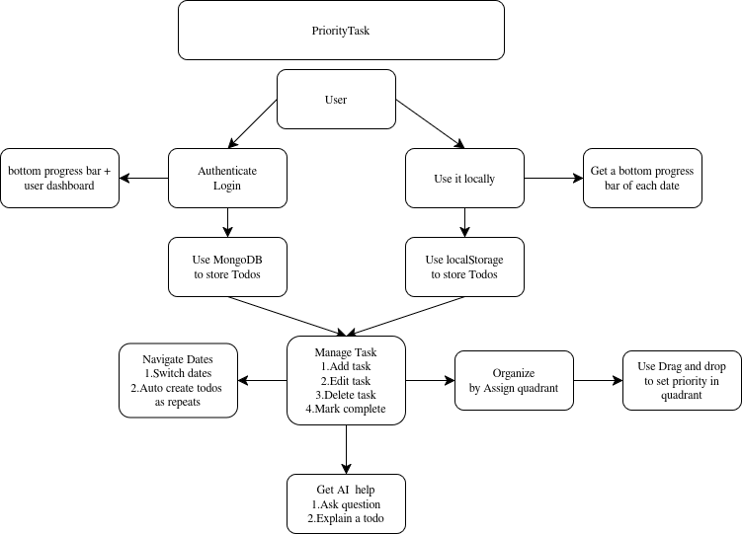
GDG On Campus LTCoE
Process flow diagram or Use-case diagram

Slide 8
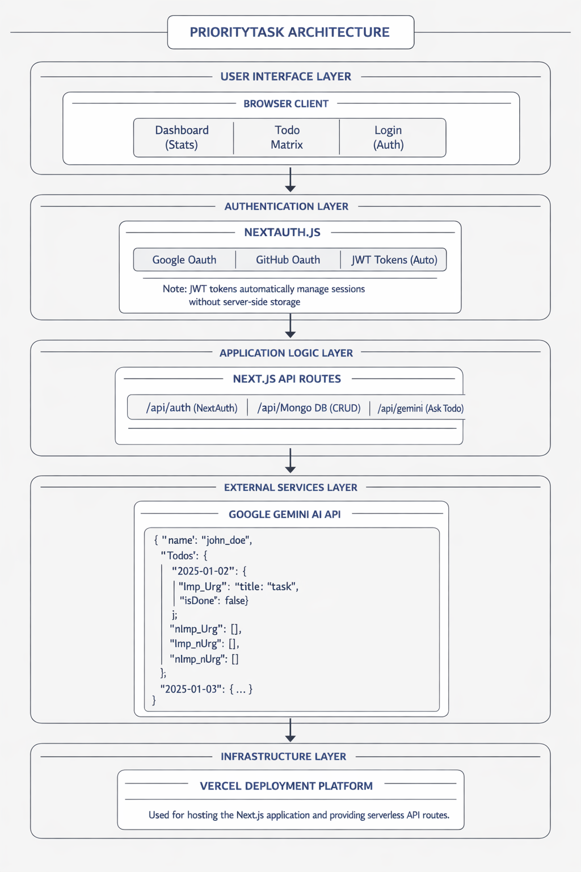
GDG On Campus LTCoE
Architecture diagram of the proposed solution
Used vercel for deployment as a next.js app
Main data structure of this app is in
lib/TodoContext.jsx named Todos(Object)
User schema includes name and Todos

Slide 9
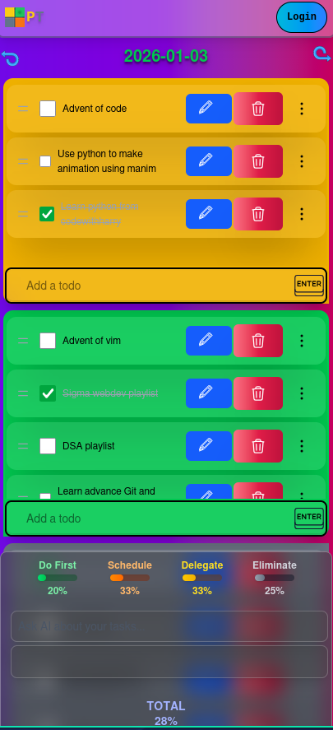
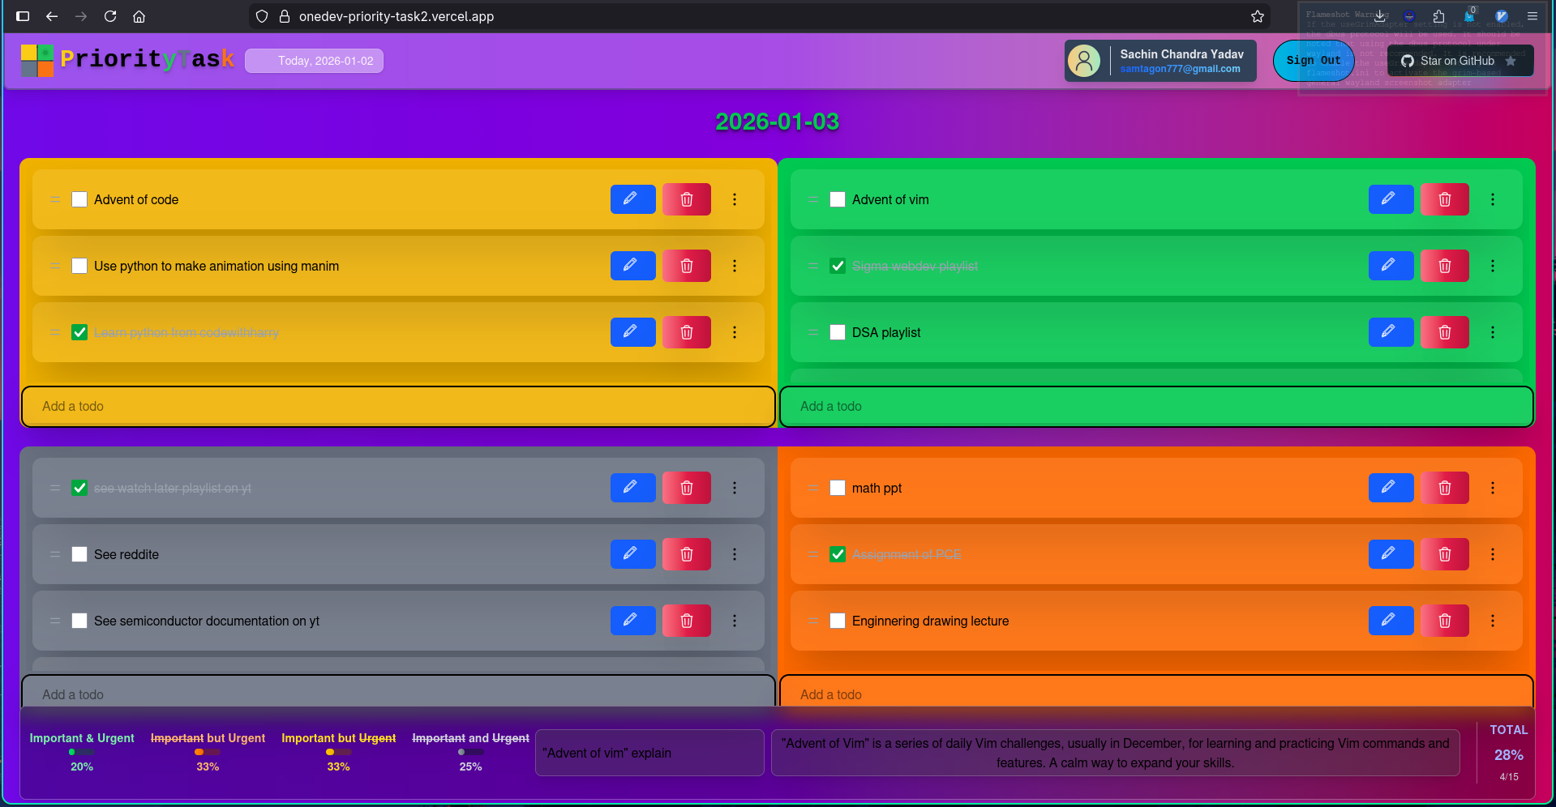
GDG On Campus LTCoE
Snapshots of the MVP

Slide 10
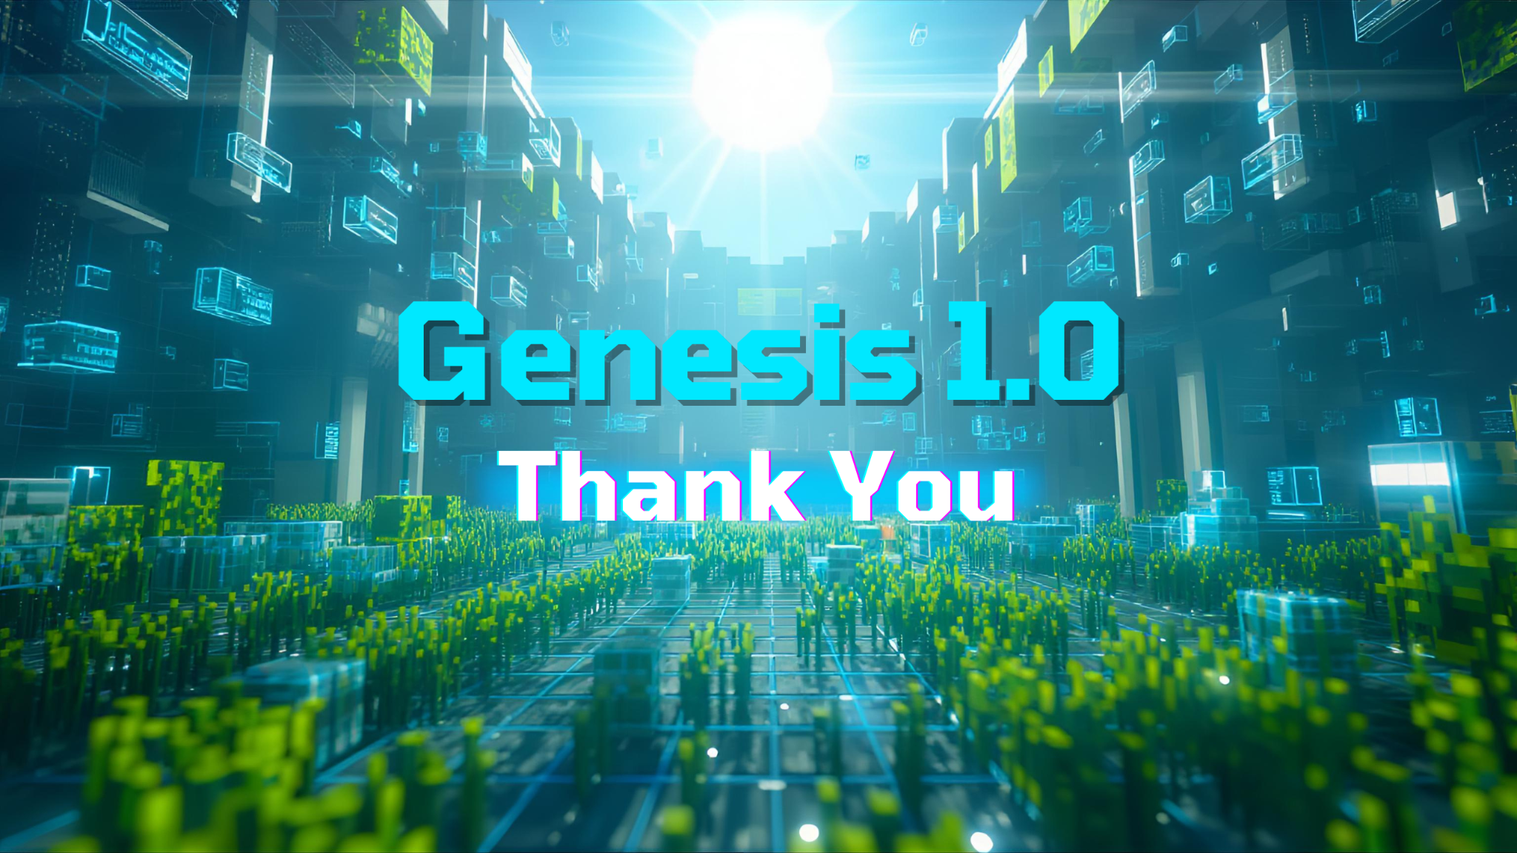
Provide links to your:
GitHub Public Repository
Demo Video Link (3 Minutes)
MVP Link
GDG On Campus LTCoE
Github repo : https://github.com/SachinyadavAug20/Onedev-PriorityTask
MVP : https://onedev-priority-task2.vercel.app/
Video link : https://youtu.be/zD5PzpIpNcI?si=xtENTWy2v70Eian5

